Slide 1

Age of Empires II game content and balance analysis
Why a game released in 1999 continues to be played today

Slide 2
Agenda
Comparison of 11 Top-Rated RTS Games on Steam^{[1]}
Longevity and Usage
What makes a game last the test of time (and fickle gamers)?
Adding new game content through updates and DLCs
Having balanced gameplay
Deep Dive: Game Balance in Age of Empires II
Recommendations

Slide 3
Game longevity and usage
Having an active player base draws new customers and is important for long-term sales. Some games drop off quickly in terms of number of players

Slide 4
Game longevity and usage
While others do not ever achieve a large player base

Slide 5
Game longevity and usage
The best RTS games are played for many years and have many players as well

Slide 6
Success Factors? Updated Content and Balance
RTS Games that are updated more frequently tend to also have more players

Slide 7
Success Factors? Updated Content and Balance
Age of Empires II’s two game versions (AoE:DE, AoE:HD) compare well against others, having more frequent updates
Game Updates AoE2:DE |  | AoE2:HD | AoE2:HD
38 Updates 21 days between updates |  | 79 Updates 40 days between updates on average | 79 Updates 40 days between updates
Game Updates (All 11 RTS Games)
 | count | frequency
mean median | 80 updates 31 updates | 70 days between updates 30 days between updates

Slide 8
Success Factors? Updated Content and Balance
We can visualize these two graphs against each other, along with their updates and begin looking into balance changes (as seen by AoEII:DE’s Major Updates )
Game Updates AoE2:DE |  | AoE2:HD | AoE2:HD
38 Updates 21 days between updates |  | 79 Updates 40 days between updates on average | 79 Updates 40 days between updates
Game Updates (All 11 RTS Games)
 | count | frequency
mean median | 80 updates 31 updates | 70 days between updates 30 days between updates
As an aside, we can clearly see the impact of the March 2020 COVID-19 lockdowns on the two games
Notes:
Graphing these two plots against each other, we get

Slide 9
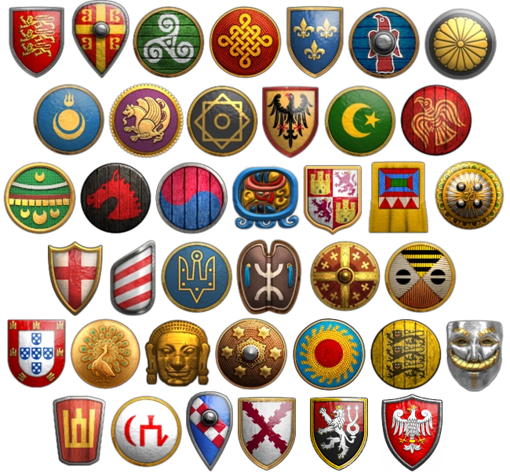
Deep Dive: Age of Empires II:DE Balance
AoE2:DE has 39 civilizations a player can pick from to play against another player online. For comparison, another popular RTS, StarCraft, has only 3 species a player can choose from.
We will analyze balance in three ways:
What is the average win rate of each civilization?
What is the win rate of each civilization against all others?
How are civilizations balanced through game updates?
Note: Our Kaggle dataset comprises of 1.3MM matches played across game modes.
Filter this to only “1v1 Standard Ranked Matches”—the de facto standard for online competitive play and tournaments. Exclude 4 civilizations we do not have data for
Notes:
First, let's look at aggregate win rates

Slide 10
Deep Dive: Age of Empires II:DE Balance
At a glance, we see that the game is well-balanced. Only the Portuguese really struggle with a 44% win rate
win rate | win rate
mean median std | 49.94% 50.23% 2.10%

Slide 11
Deep Dive: Age of Empires II:DE Balance
1)
At a glance, we see that the game is well-balanced. But, Franks win about 55% of matches and Koreans only win 45%
win rate | win rate
mean median std | 49.87% 50.36% 2.33%
Notes:
But this is balance only at the aggregate level. Does this change if we look at civ vs civ win rates?

Slide 12
AoE2:DE Balance
Most civilizations are evenly matched ( )
But the Portuguese just can’t seem to catch a break ☹
About 70% of Turks vs. Portuguese matchups ( ) results in a Turkish victory

Slide 13
AoE2:DE Balance
2)
Most civilizations are evenly matched ( ) against others
But the Koreans just can’t seem to catch a break ☹
Only about 33% of Koreans vs. Khmer matchups ( ) results in a Korean victory

Slide 14
AoE2:DE Balance
3)
Most civilizations are evenly matched ( ) against others
But the Koreans just can’t seem to catch a break ☹
Only about 33% of Koreans vs. Khmer matchups ( ) results in a Korean victory
Oddly, the Koreans win rate went down in the latest patch!

Slide 15
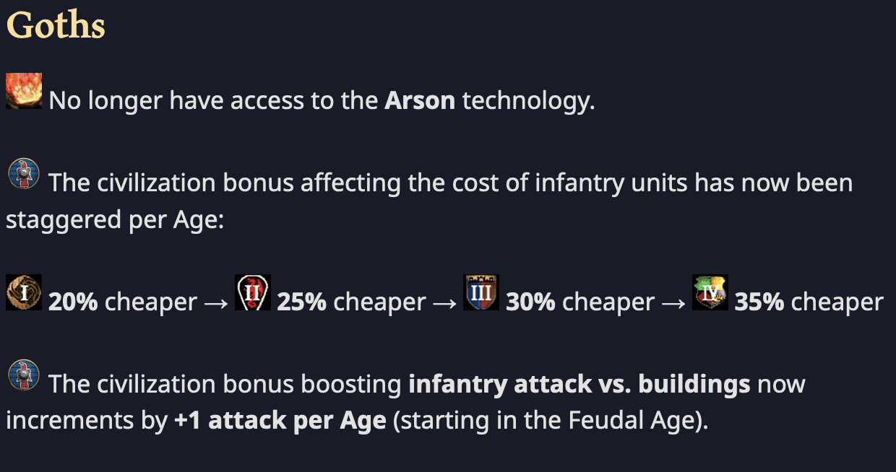
AoE2:DE Balance
How is this achieved? Through civilization ”nerfs” and “buffs”
AoEII:DE Update 36202 ^{[1]} ”nerfed” Goths
[1] https://www.ageofempires.com/news/aoe2de-update-36202

Slide 16
AoE2:DE Balance
How is balance achieved? Through civilization ”nerfs” and “buffs”
Usually, developers want to weaken strong civilizations—the Goths were very strong at launch
AoEII:DE Update 36202 ^{[1]} ”nerfed” Goths
[1] https://www.ageofempires.com/news/aoe2de-update-36202

Slide 17
Recommendations and Next Steps
Age of Empires II has maintained player interest for over 20 years by updating game content and focusing on balancing gameplay
A game studio seeking to emulate this type of long-term success should:
Continue to add new features to maintain player interest
Analyze balance in multiplayer games post-launch and rebalance over- or under-powered civilizations/species/etc.
For further analysis, we could consider:
Analyzing balance across multiple RTS games
Expanding our analysis to the original 1999 Age of Empires II release and subsequent 2001 expansion
Do revenue and cost analysis on these games, taking into consideration profitability of game development work for content and balance updates

